Slide 1
Sensation and perception

Slide 2
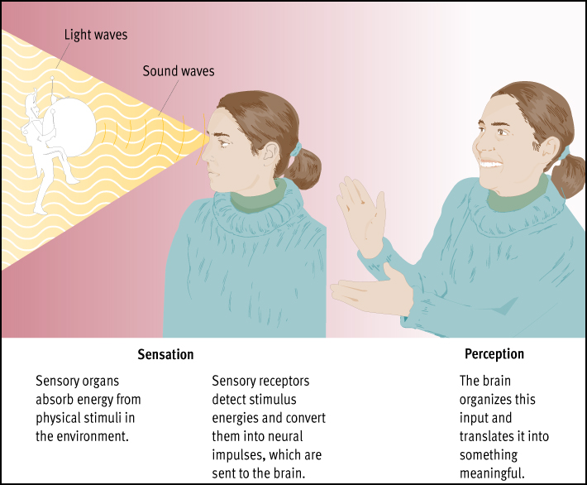
Figure 4.1
The distinction between sensation and perception. Sensation involves the stimulation of sensory organs, whereas perception involves the processing and interpretation of sensory input. As this illustration shows, the two processes merge at the point where sensory receptors convert physical energy into neural impulses.

Slide 3
Some key terms
Perceptual Features: Basic stimulus patterns
Sensory Coding: Converting important features of the world into neural messages understood by the brain
Sensory Localization: Type of sensations you experience depends on which area of the brain is activated

Slide 4
General properties of sensory systems
Sensation: Process of detecting physical energies with sensory organs
Perception: Mental process of organizing sensations into meaningful patterns
Data Reduction System: Any system that selects, analyzes, and condenses information (e.g., the sensory systems)
Transducer: A device that converts energy from one system into energy in another (e.g., the receptors)

Slide 5
Vision
Visible Spectrum: Part of the electromagnetic spectrum to which the eyes respond
Lens: Structure in the eye that focuses light rays
Photoreceptors: Light-sensitive cells in the eye—2 kinds
Cornea: Transparent membrane covering the front of the eye; bends light rays
Retina: Light-sensitive layer of cells in the back of the eye; contains the photoreceptors
Easily damaged from excessive exposure to light (staring at an eclipse)

Slide 6
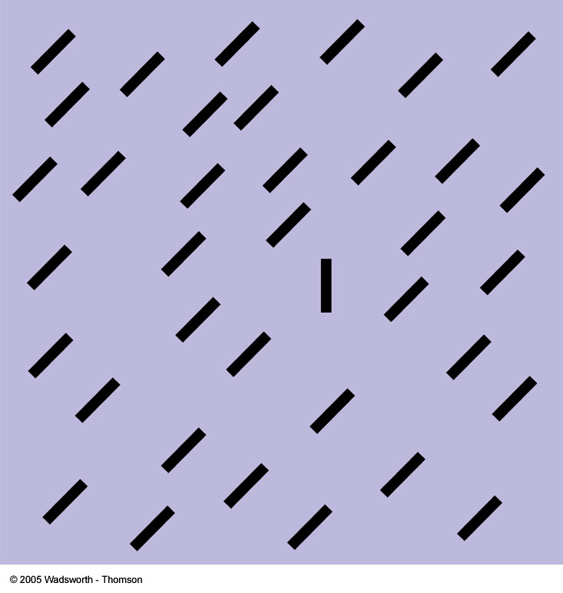
FIGURE 4.1 Visual pop-out. (Adapted from Ramachandran, 1992b.) Pop-out is so basic that babies as young as 3 months respond to it

Slide 7
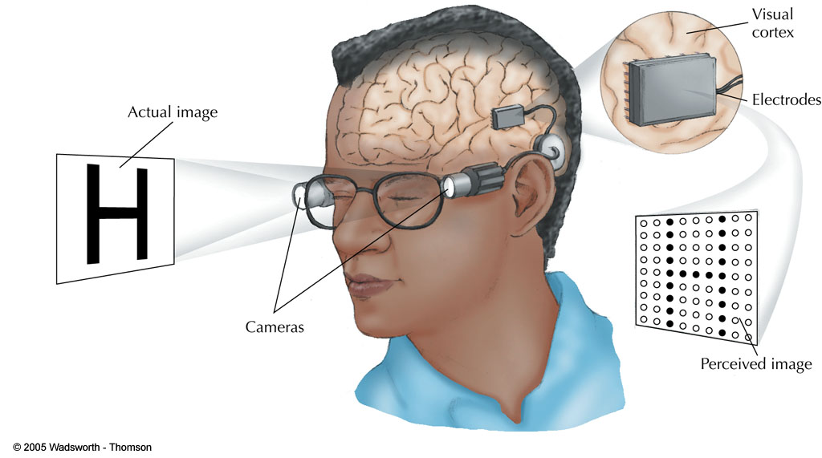
FIGURE 4.2 An artificial visual system.

Slide 8
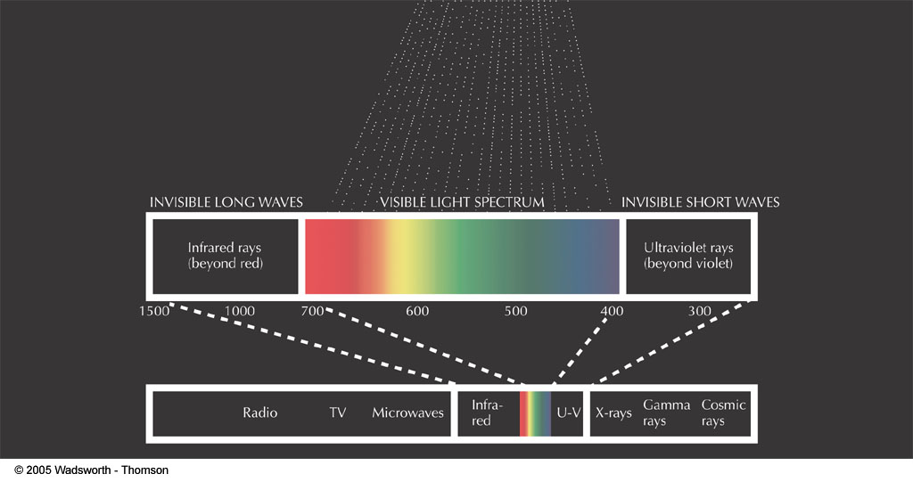
FIGURE 4.3 The visible spectrum.

Slide 9
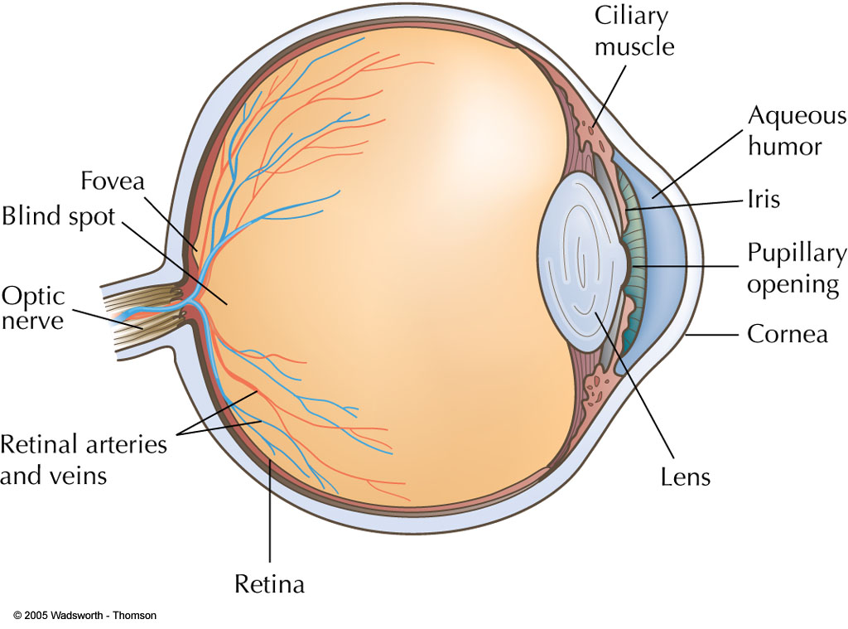
FIGURE 4.4 The human eye, a simplified view.

Slide 10
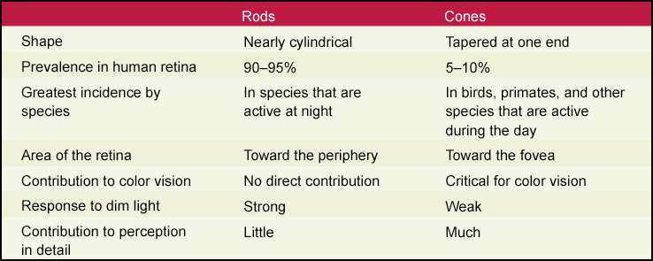
TABLE 4.1 Differences Between Rods and Cones
Notes:
The cones are utilized in color vision, daytime vision and detail vision. The rods are adapted for vision in dim light. Species that are active at night have few cones and many rods, giving them particularly good night vision.
The fovea is the center of the human retina, and the location of the highest proportion of cones. It is the area of the eye with the greatest acuity. Rods are more plentiful in the periphery of the retina.

Slide 11
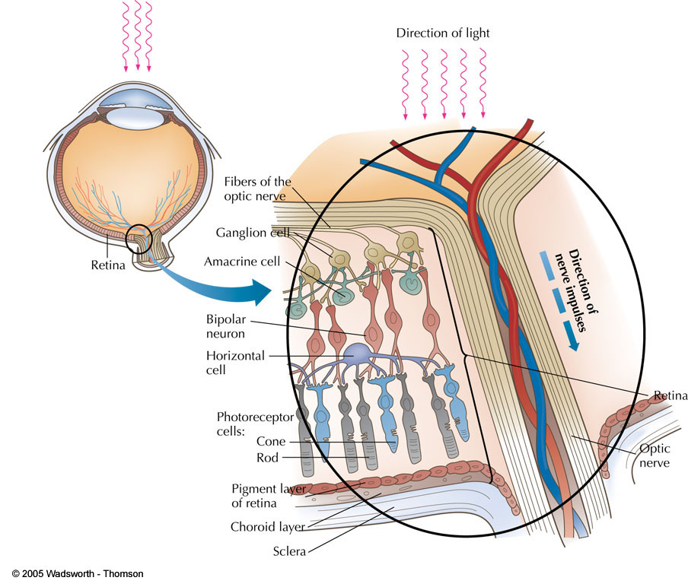
Fig.: 4.6: Anatomy of a retina
Notes:
FIGURE 4.6 Anatomy of the retina. Note that light does not fall directly on the rods and cones. It must first pass through the cornea, the lens, the vitreous humor (a jelly-like substance that fills the eyeball) and the outer layers of the retina. Only about one half of the light at the front of the eye reaches the rods and cones— testimony to the retina’s sensitivity. The lower left photograph shows rods and cones as seen through an electron microscope. In the photograph, the cones are colored green and the rods blue.

Slide 12
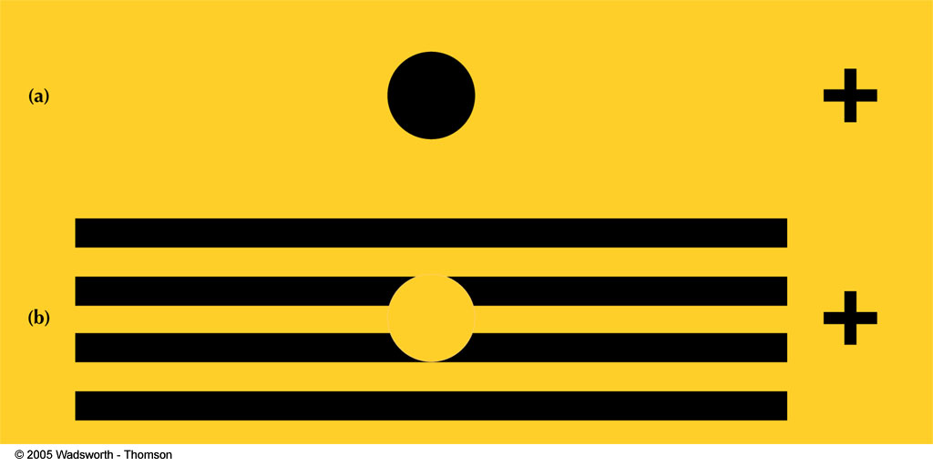
Fig.: 4.7: Experiencing a blind spot
Notes:
FIGURE 4.7 Experiencing the blind spot. (a) With your right eye closed, stare at the upper right cross. Hold the book about 1 foot from your eye and slowly move it back and forth. You should be able to locate a position that makes the black spot disappear. When it does, it is on your blind spot. With a little practice you can learn to make people or objects you dislike disappear too! (b) Repeat the procedure described, but stare at the lower cross. When the white space falls on the blind spot, the black lines will appear to be continuous. This may help you understand why you do not usually notice a blind spot in your visual field.

Slide 13
Vision problems
Hyperopia: Difficulty focusing nearby objects (farsightedness)
Myopia: Difficulty focusing distant objects (nearsightedness)
Astigmatism: Corneal, lens, or eye defect that causes some areas of vision to be out of focus; relatively common
Presbyopia: Farsightedness caused by aging

Slide 14
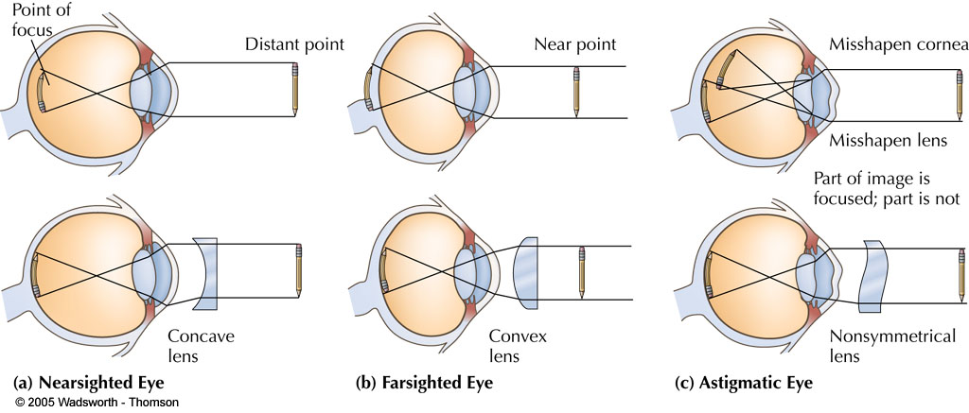
Fig. 4.5: Visual defects and corrective lens
Notes:
FIGURE 4.5 Visual defects and corrective lenses: (a) A myopic (longer than usual) eye. The concave lens spreads light rays just enough to increase the eye’s focal length. (b) A hyperopic (shorter than usual) eye. The convex lens increases refraction (bending), to focus light on the retina. (c) An astigmatic (lens or cornea not symmetrical) eye. In astigmatism, parts of vision are sharp and parts are unfocused. Lenses that correct astigmatism are non-symmetrical.

Slide 15
Light control
Cones: Visual receptors for colors and bright light (daylight); have 6.5 million
Rods: Visual receptors for dim light; only produce black and white; have 100 million
Blind Spot: Area of the retina lacking visual receptors

Slide 16
Visual Acuity: Sharpness of visual perception
Fovea: Area of the retina containing only cones
Peripheral Vision: Vision at edges of visual field; side vision
Many superstar athletes have excellent peripheral vision

Slide 17
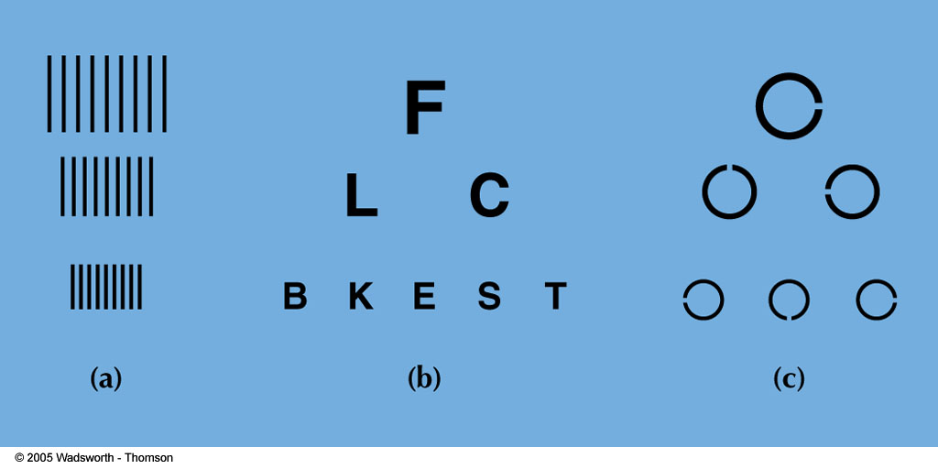
FIGURE 4.8 Tests of visual acuity. Here are some common tests of visual acuity. In (a)sharpness is indicated by the smallest grating still seen as individual lines. The Snellen chart (b) requires that you read rows of letters of diminishing size until you can no longer distinguish them. The Landolt rings (c) require no familiarity with letters. All that is required is a report of which side has a break in it.

Slide 18
Colour vision
Trichromatic Theory: Color vision theory that states we have three cone types: red, green, blue
Other colors produced by a combination of these
Black and white produced by rods

Slide 19
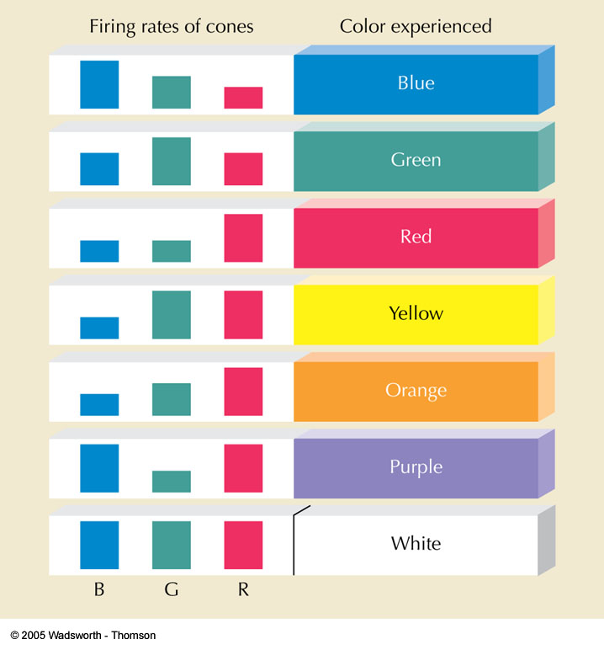
FIGURE 4.10 Firing rates of blue, green, and red cones in response to different colors. The taller the colored bar, the higher the firing rates for that type of cone. As you can see, colors are coded by differences in the activity of all three types of cones in the normal eye.

Slide 20
Opponent Process Theory: Color vision theory based on three “systems”: red or green, blue or yellow, black or white
Exciting one color in a pair (red) blocks the excitation in the other member of the pair (green)
Afterimage: Visual sensation that remains after stimulus is removed (seeing flashbulb after the picture has been taken)

Slide 21
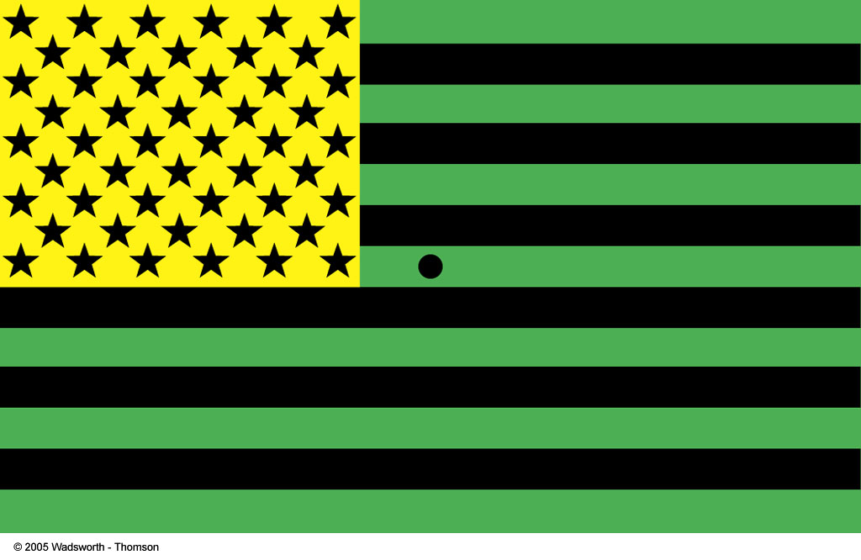
Fig. 4.9: Negative afterimages
Notes:
FIGURE 4.9 Negative afterimages. Stare at the dot near the middle of the flag for at least 30 seconds. Then look immediately at a plain sheet of white paper or a white wall. You will see the American flag in red, white, and blue. Reduced sensitivity to green, black, and yellow in the visual system, caused by prolonged staring, produces the complementary colors.

Slide 22

Notes:
Stare at the left image of the Flag for about 30 seconds without moving your eyes too much and then quickly move your vision to stare at a white background. See the Flag in normal Red, White and Blue?

Slide 23
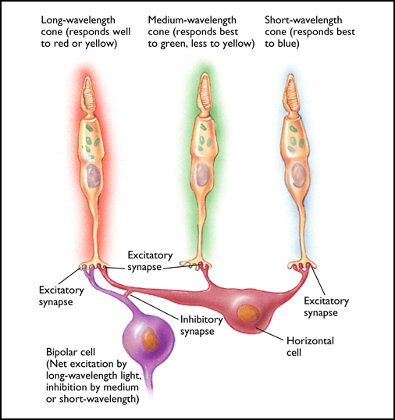
Fig.: 4.16: Explaining negative afterimages
Notes:
The negative afterimages that we experience after staring at objects are results of the alternating stimulation and inhibition of neurons in the visual system.
A bipolar neuron that responds strongly to yellow will be inhibited by blue.
After you’ve stared at a yellow object, your fatigued bipolar cell will behave as if it’s been inhibited, and yield a sensation of blue.
Figure 4.16
One way to explain negative afterimages: Long-wavelength (“red”) light produces net excitation in this bipolar cell. Medium- or short-wavelength light produces inhibition. Because short-wavelength cones are scarce, such a cell as this one is mostly inhibited by medium-wavelength (“green”) light. When the bipolar cell is excited, it produces a perception of red. But when it is fatigued, it responds less than usual, as if it were being inhibited, and therefore yields a perception of green.

Slide 24
Colour blindness
Inability to perceive colors
Total color blindness is rare
Color Weakness: Inability to distinguish some colors
Red-green is most common; much more common among men than women
Recessive, sex-linked trait on X chromosome
Ishihara Test: Test for color blindness and color weakness

Slide 25
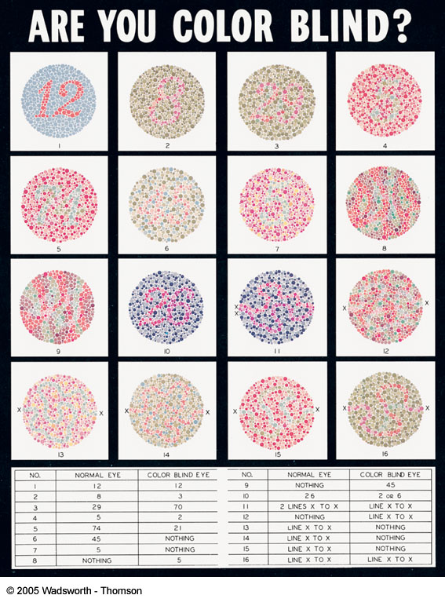
FIGURE 4.12 A replica of the Ishihara test for color blindness.

Slide 26
Dark adaptation
Increased retinal sensitivity to light after entering the dark; similar to going from daylight into a dark movie theater
Rhodopsin: Light-sensitive pigment in the rods

Slide 27
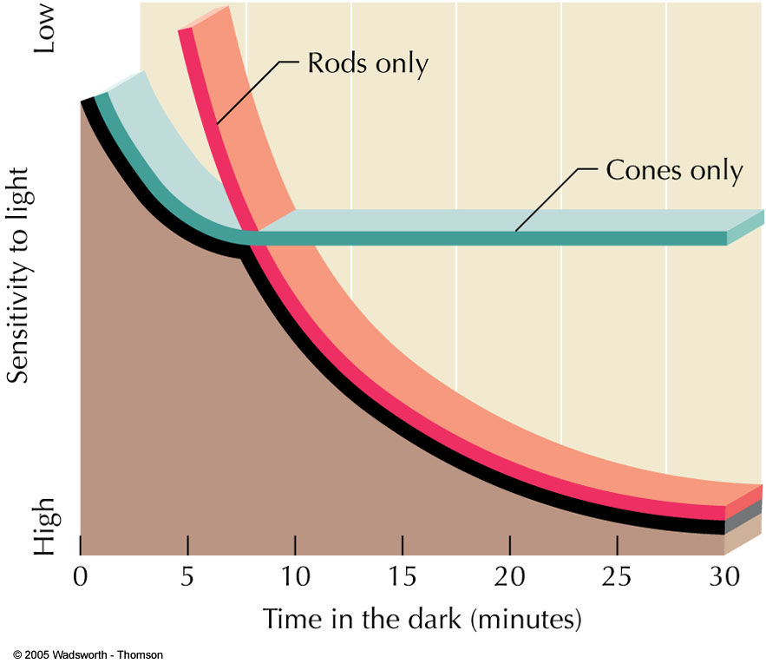
Fig. 4.13: Typical course of dark adaptation
Notes:
FIGURE 4.13 Typical course of dark adaptation. The black line shows how the threshold for vision lowers as a person spends time in the dark. (A lower threshold means that less light is needed for vision.) The green line shows that the cones adapt first, but they soon cease adding to light sensitivity. Rods, shown by the red line, adapt more slowly. However, they continue to improve night vision long after the cones are fully adapted.

Slide 28
Hearing
Sound Waves: Rhythmic movement of air molecules
Pitch: Higher or lower tone of a sound
Loudness: Sound intensity

Slide 29
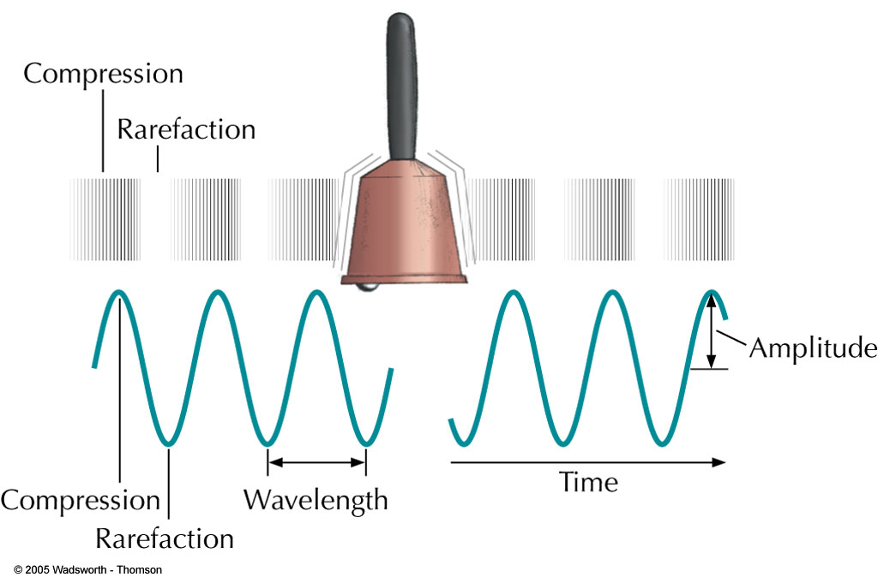
FIGURE 4.14 Waves of compression in the air, or vibrations, are the stimulus for hearing. The frequency of sound waves determines their pitch. The amplitude determines loudness.

Slide 30
Parts of the ear
Pinna: External part of the ear
Tympanic Membrane: Eardrum
Auditory Ossicles: Three small bones that vibrate; link eardrum with the cochlea
Malleus (hammer)
Incus (anvil)
Stapes (stirrup)

Slide 31
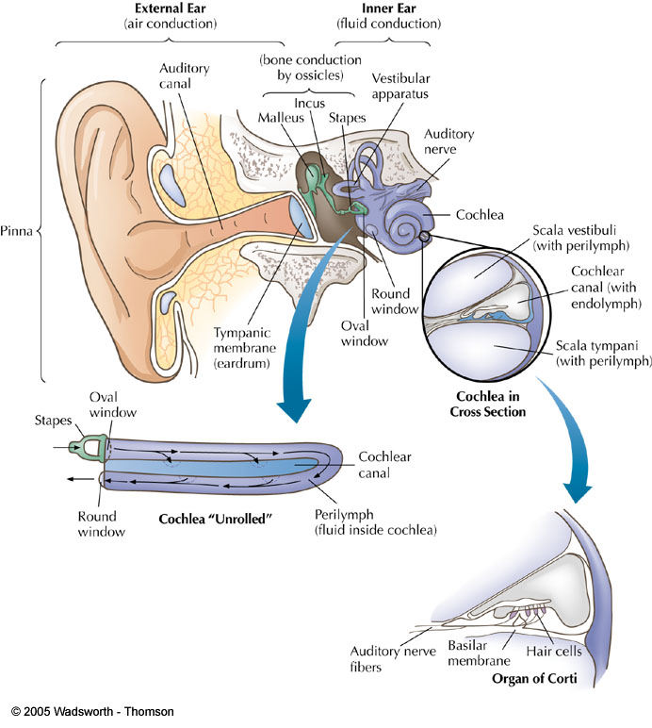
Fig. 4.15: Anatomy of the ear
Notes:
FIGURE 4.15 Anatomy of the ear. The inset in the foreground (Cochlea “Unrolled”) shows that as the stapes moves the oval window, the round window bulges outward, allowing waves to ripple through fluid in the cochlea. The waves move membranes near the hair cells, causing cilia or “bristles” on the tips of the cells to bend. The hair cells then generate nerve impulses carried to the brain. (See an enlarged cross section of cochlea in Figure 4.16.)
Pinna: External part of the ear
Tympanic Membrane: Eardrum
Auditory Ossicles: Three small bones that vibrate; link eardrum with the cochlea
Malleus (hammer)
Incus (anvil)
Stapes (stirrup)
Cochlea: Organ that makes up inner ear; snail-shaped; organ of hearing
Hair Cells: Receptor cells within cochlea that transduce vibrations into nerve impulses
Once dead they are never replaced
Organ of Corti: Center part of the cochlea containing hair cells, canals, and membranes

Slide 32
Cochlea: Organ that makes up inner ear; snail-shaped; organ of hearing
Hair Cells: Receptor cells within cochlea that transduce vibrations into nerve impulses
Once dead they are never replaced
Organ of Corti: Center part of the cochlea containing hair cells, canals, and membranes

Slide 33
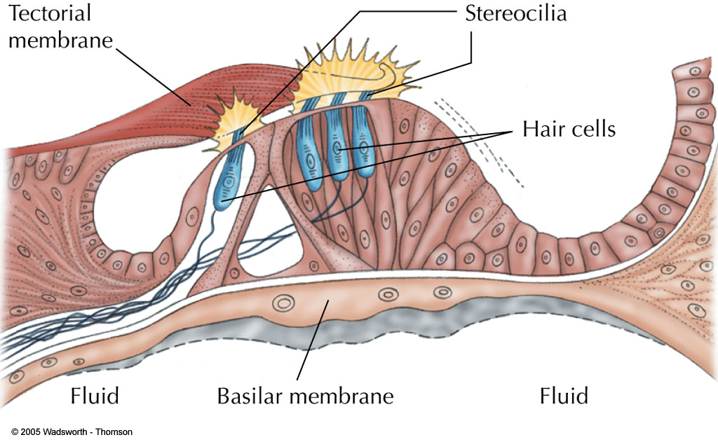
FIGURE 4.16 A closer view of the hair cells shows how movement of fluid in the cochlea causes the bristling “hairs” or cilia to bend, generating a nerve impulse.

Slide 34
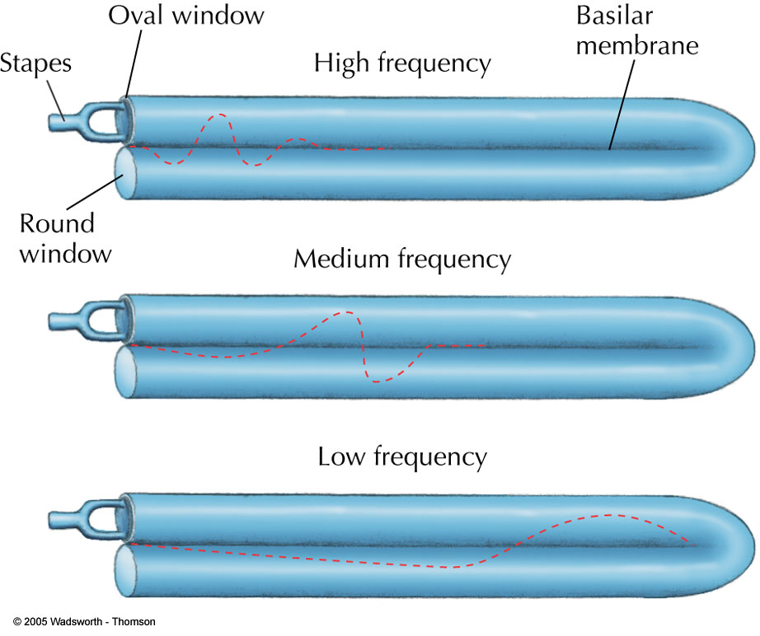
Fig. 4. 17: Cochlea unrolled
Notes:
FIGURE 4.17 Here we see a simplified side view of the cochlea “unrolled.” Remember that the basilar membrane is the elastic “roof” of the lower chamber of the cochlea. The organ of Corti, with its sensitive hair cells, rests atop the basilar membrane. The colored line shows where waves in the cochlear fluid cause the greatest deflection of the basilar membrane. (The amount of movement is exaggerated in the drawing.) The area of greatest movement helps identify sound frequency.

Slide 35
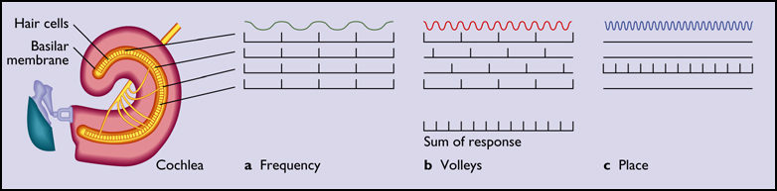
Detecting high/low sounds
Frequency Theory: As pitch rises, nerve impulses of the same frequency flow into the auditory nerve
Place Theory: Higher and lower tones excite specific areas of the cochlea
Notes:
The auditory system responds differently to low-, medium-, and high-frequency tones. (a) At low frequencies hair cells at many points along the basilar membrane produce impulses in synchrony with the sound waves. (b) At medium frequencies different cells produce impulses in synchrony with different sound waves, but the group as a whole still produces one or more impulses for each wave. (c) At high frequencies only one point along the basilar membrane vibrates; hair cells at other locations remain still.

Slide 36
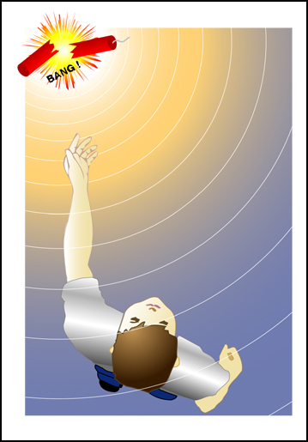
Localization of sounds
How does the auditory system determine the source of a sound?
To estimate the approximate location of origin of a sound, the auditory system compares the messages received by the two ears.
The sound waves will arrive at the closer ear slightly sooner (if coming from the right, it arrives at the right ear just a little before it arrives at the left ear.)
Figure 4.24
The stereophonic hearing of our ears enables us to determine where a sound is coming from. The ear located closest to the sound will receive the sound waves first. A change of less than one ten-thousandth of 1 second can alter our perception of the location of a sound source.
Notes:
Localization of Sounds
How does the auditory system determine the source of a sound?
To estimate the approximate location of origin of a sound, the auditory system compares the messages received by the two ears.
The sound waves will arrive at the closer ear slightly sooner (if coming from the right, it arrives at the right ear just a little before it arrives at the left ear.)
Also,
The distance of a sound can be estimated based on loudness and pitch.
A sound that is growing louder is interpreted as approaching.
A higher frequency sound is interpreted as nearer than a low frequency sound; a sound that is increasing in pitch is interpreted as approaching.
The only cue for absolute distance is the amount of reverberation experienced by the listener.

Slide 37
Deafness
Conduction Deafness: Poor transfer of sounds from tympanic membrane to inner ear
Compensate with amplifier (hearing aid)
Nerve Deafness: Caused by damage to hair cells or auditory nerve
Hearing aids useless in these cases, since auditory messages cannot reach the brain
Cochlear Implant: Electronic device that stimulates auditory nerves; still not very successful

Slide 38
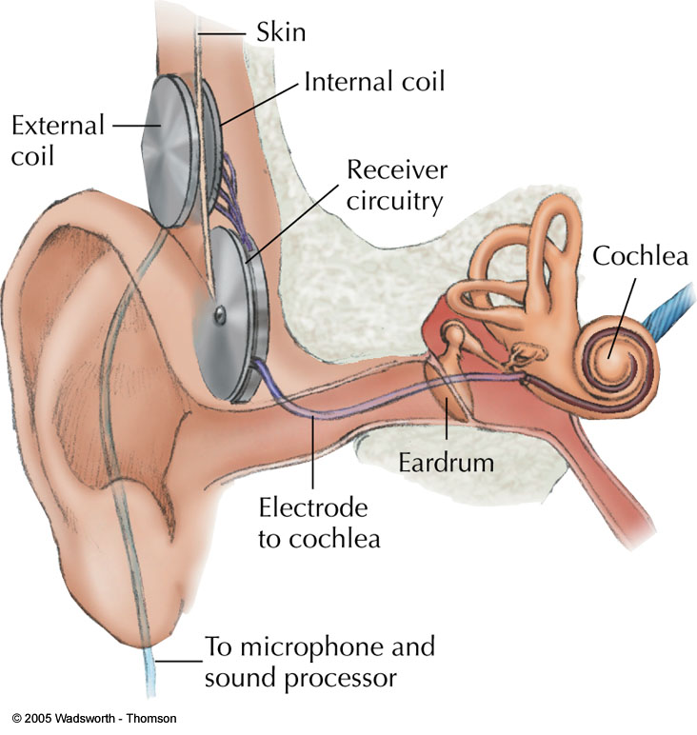
FIGURE 4.18 A cochlear implant, or “artificial ear.”

Slide 39
Preventable hearing problems
Stimulation Deafness: Damage caused by exposing hair cells to excessively loud sounds
Typical at rock concerts
By age 65, 40% of hair cells are gone

Slide 40
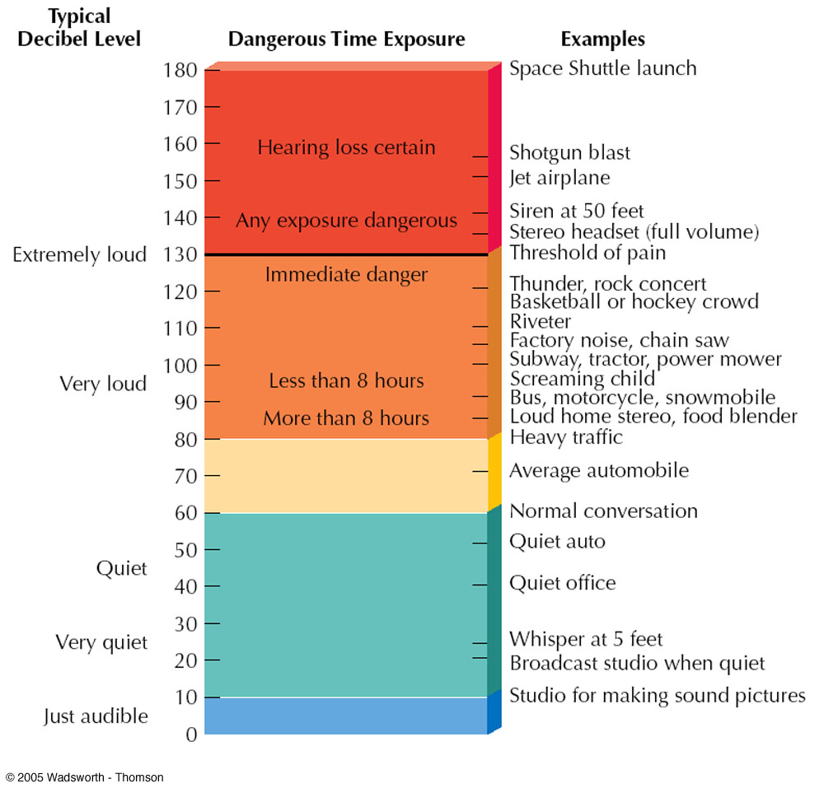
FIGURE 4.20 The loudness of sound is measured in decibels. Zero decibels is the faintest sound most people can hear. Sounds of 110 decibels are uncomfortably loud. Prolonged exposure to sounds above 85 decibels may damage the inner ear. Rock music, which may be 120 decibels, has caused hearing loss in musicians and may affect audiences as well. Sounds of 130 decibels pose an immediate danger to hearing.

Slide 41
Smell and taste
Olfaction: Sense of smell
Anosmia: Defective sense of smell
Lock and Key Theory: Odors are related to the shape of chemical molecules

Slide 42
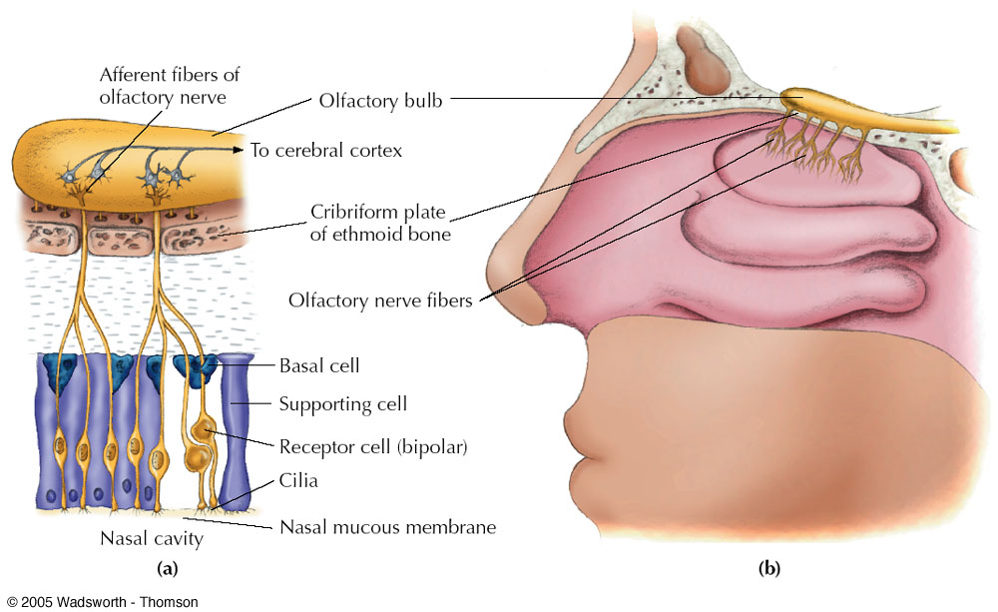
FIGURE 4.21 (a) Olfactory nerve fibers respond to gaseous molecules. Receptor cells are shown in cross section to the left. (b) Olfactory receptors are located in the upper nasal cavity. (c) On the right, an extreme close-up of an olfactory receptor shows fibers that sense gaseous molecules of various shapes.

Slide 43
Gustation
Gustation: Sense of taste
Taste Buds: Taste-receptor cells
Four Taste Sensations: sweet, salty, sour, bitter
Most sensitive to bitter, least sensitive to sweet
Umami: Possible fifth taste sensation; brothy taste

Slide 44
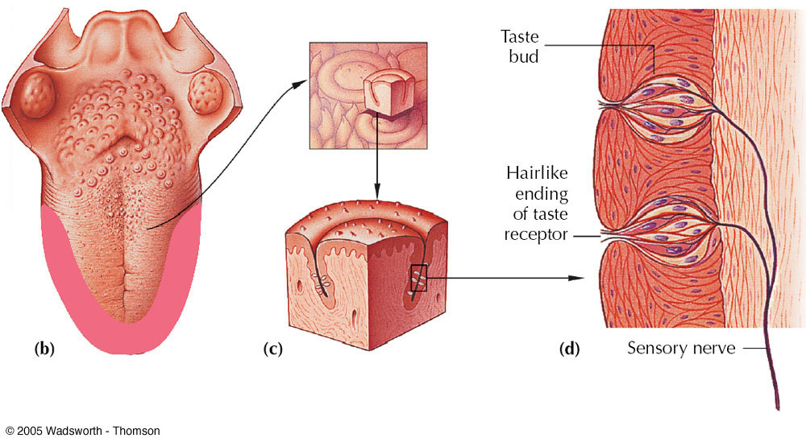
FIGURE 4.22 Receptors for taste
Notes:
(a) The tongue is covered with small protrusions called papillae. (b) Most taste buds are found around the top edges of the tongue (shaded area). However, some are located elsewhere, including under the tongue. Stimulation of the central part of the tongue causes no taste sensations. All four primary taste sensations occur anywhere that taste buds exist. (c) An enlarged drawing shows that taste buds are located near the base of papillae. (d) Detail of a taste bud. These receptors also occur in other parts of the digestive system, such as the lining of the mouth. (Fig. 4.22). As food is chewed, it dissolves and enters the taste buds, where it sets off nerve impulses.Much like smell, sweet and bitter tastes appear to be based on a lock-and key match between molecules and intricately shaped receptors. Saltiness and sourness, however, are triggered by a direct flow of charged atoms into the tips of taste cells (Lindemann, 2001)

Slide 45
Somesthetic sensation
Skin Senses (Touch): Light touch, pressure, pain, heat, cold, warmth
Kinesthetic: Detect body position and movement
Vestibular: Balance, position in space, and acceleration

Slide 46
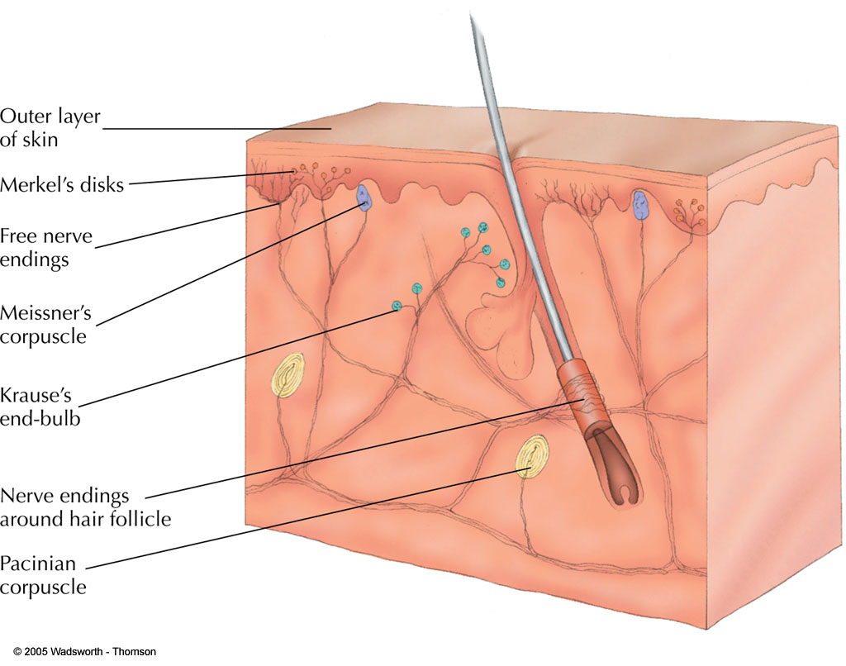
FIGURE 4.23 The skin senses include touch, pressure, pain, cold, and warmth: different forms the skin receptors can take.
Notes:
The only clearly specialized receptor is the Pacinian corpuscle, which is highly sensitive to pressure. Free nerve endings are receptors for pain and any of the other sensations. For reasons that are not clear, cold is sensed near the surface of the skin, and warmth is sensed deeper (Carlson, 1998).

Slide 47
Pain
Warning System: Pain carried by large nerve fibers; sharp, bright, fast pain that tells you body damage may be occurring (e.g., knife cut)
Reminding System: Small Nerve Fibers: Slower, nagging, aching, widespread; gets worse if stimulus is repeated; reminds system that body has been injured

Slide 48
Vestibular system
Otolith Organs: Sensitive to movement, acceleration, and gravity
Semicircular Canals: Fluid-filled tubes in ears that are sensory organs for balance
Crista: “Float” that detects movement in semicircular canals

Slide 49
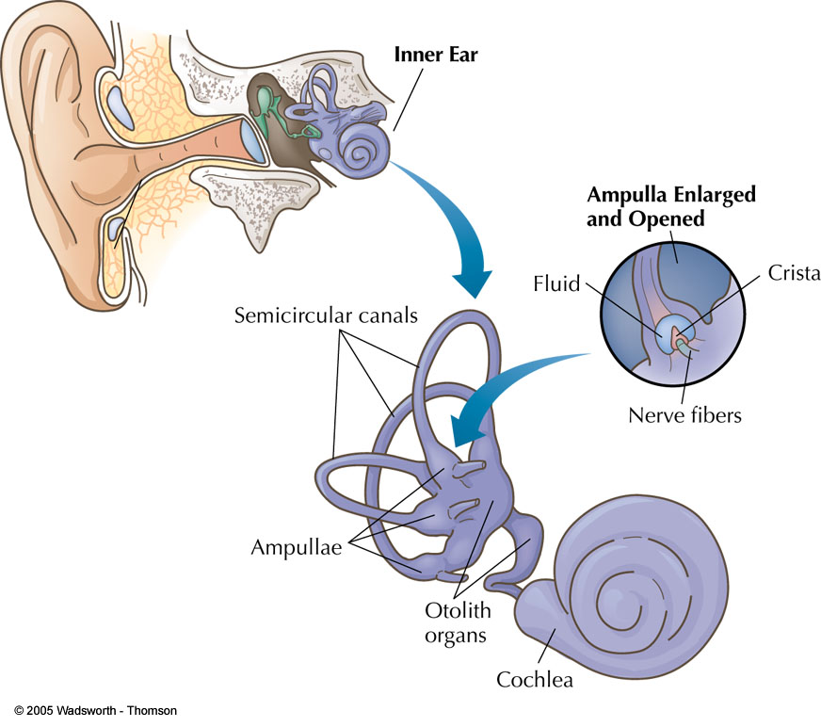
FIGURE 4.24 The vestibular system

Slide 50
Vestibular system and motion sickness
Motion sickness is directly related to vestibular system.
Sensory Conflict Theory: Motion sickness occurs because vestibular system sensations do not match sensations from the eyes and body.
After spinning and stopping, fluid in semicircular canals is still spinning, but head is not.
Mismatch leads to sickness.
Medications, relaxation, and lying down might help.

Slide 51
Adaptation, attention and sensory gating
Sensory Adaptation: When sensory receptors respond less to unchanging stimuli
Selective Attention: Voluntarily focusing on a specific sensory input
Sensory Gating: When some incoming nerve impulses are blocked while others are allowed to reach the brain

Slide 52
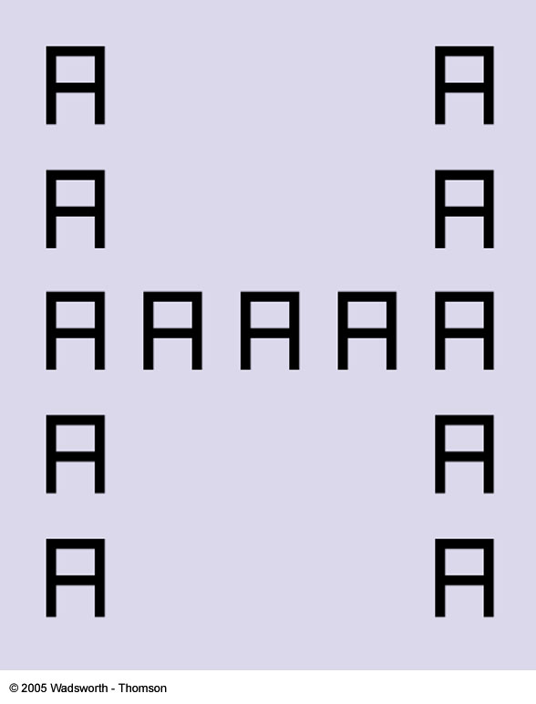
FIGURE 4.25 The attentional “spotlight” can be widened or narrowed. If you focus on local details in this drawing you will see the letter A repeated 13 times. If you broaden your field of attention to encompass the overall pattern, you will see the letter H.

Slide 53
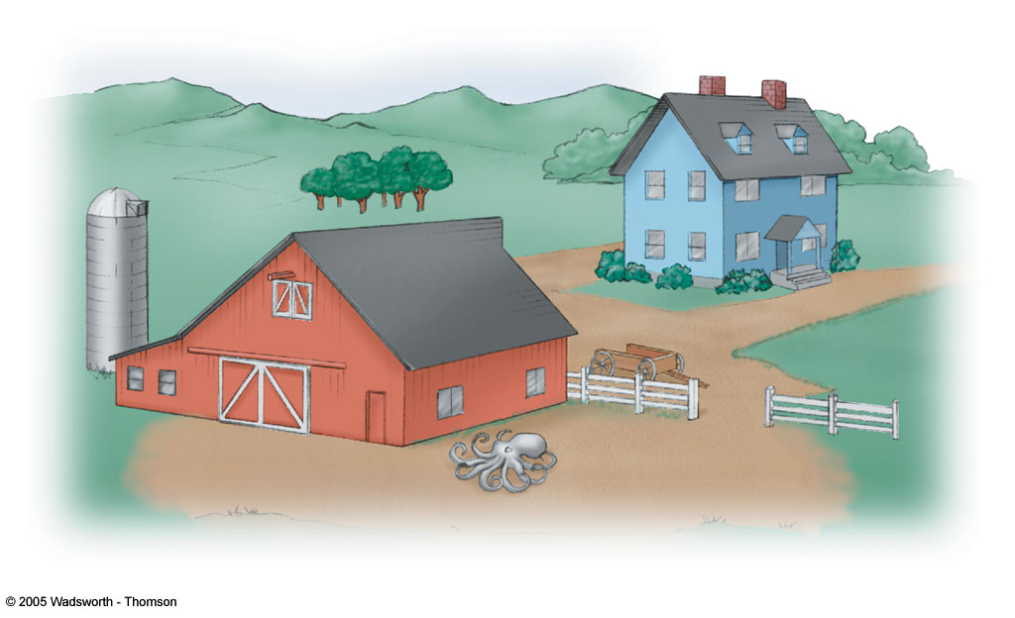
FIGURE 4.26 One of the drawings used by Mackworth and Loftus (1978) to investigate attention. Observers attend to unexpected objects longer than they do to expected objects. In this drawing, observers looked longer at the octopus than they did at a tractor placed in the same spot. What do you think would happen if a tractor were shown upside down or on the roof of the barn?

Slide 54
Gate control theory of pain
Gate Control Theory: Pain messages from different nerve fibers pass through the same “neural” gate in the spinal cord.
If gate is closed by one pain message, other messages may not be able to pass through.
Counterirritation: When messages from large, fast nerve fibers close spinal pain gate directly.
This prevents slower, “reminding system” pain from reaching the brain.
Acupuncture’s efficacy may be explained by this theory

Slide 55
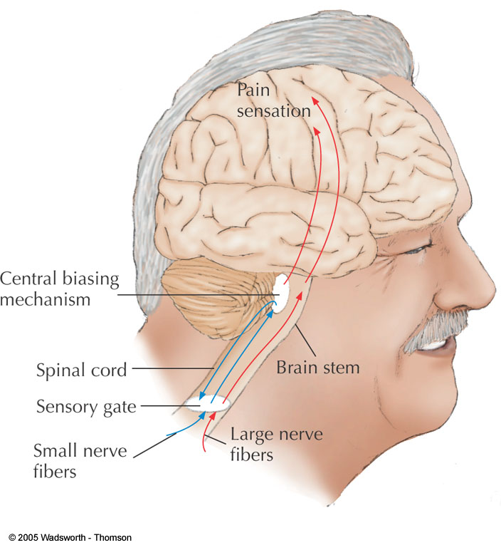
FIGURE 4.27 Diagram of a sensory gate for pain. A series of pain impulses going through the gate may prevent other pain messages from passing through. Or pain messages may relay through a “central biasing mechanism” that exerts control over the gate, closing it to other impulses.

Slide 56
Psychophysics
Study of the relationship between the physical properties of stimuli and a person’s experience of them (Fechner, 1860)
Absolute threshold: minimum amount of energy we can detect (detection)
Difference threshold: the smallest change in a stimulus we can detect (just noticeable difference) (discrimination)

Slide 57
Perception
Size Constancy: Perceived size of an object remains the same, DESPITE changes in its retinal image
Native Perception: A perceptual experience based on innate processes
Empirical Perception: A perception based on prior experience
Shape Constancy: The perceived shape of an object unaffected by changes in its retinal image
Brightness Constancy: Apparent brightness of an object stays the same under changing lighting conditions

Slide 58
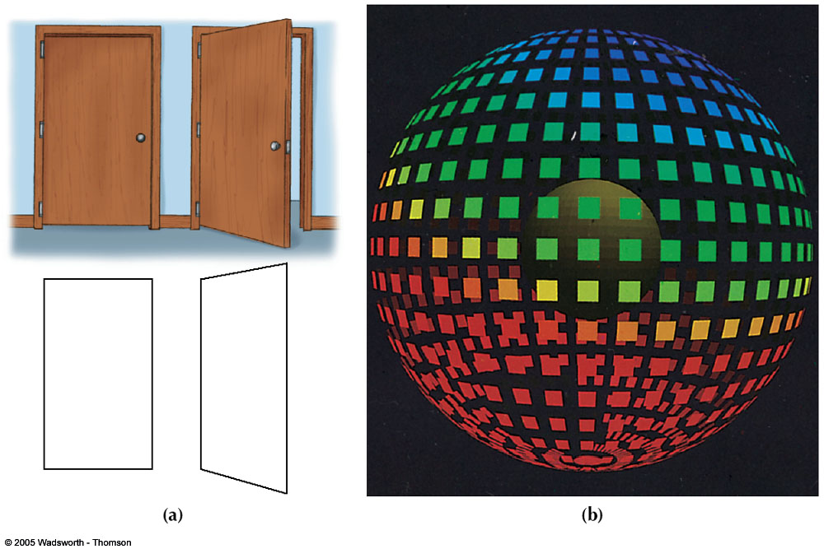
FIGURE 4.28 Shape constancy. (a) When a door is open, its image actually forms a trapezoid. Shape constancy is indicated by the fact that it is still perceived as a rectangle. (b)With great effort you may be able to see this design as a collection of flat shapes. However, if you maintain shape constancy, the distorted squares strongly suggest the surface of a sphere.

Slide 59
Visual perception
How do we organize sensations into meaningful perceptions?
Perceptual constructions—mental representations of external events—that are actively created by your brain
Does your brain ever misconstruct (and thus misperceive) external stimuli?

Slide 60

Subliminal activity
James Vicary ignited a firestorm of controversy when he introduced subliminal advertising.
Notes:
Subliminal advertising first came to the public’s attention in 1957, when Jim Vicary conducted a subliminal advertising strategy of interspersing "drink Coca-Cola" and "eat popcorn" messages on a movie screen so quickly that they could not be seen consciously by the audience. His research initially reported increases in the sales of both Coca-Cola and popcorn as a result of subliminal messages. Later, however, when he was challenged and could not replicate or even produce the results, Vicary admitted that the results of the initial study had been fabricated. However, the study was the focus of much public attention. Consumers were concerned that advertisers could now "trick" them into buying products with out their knowledge and/or conscious opposition since the advertising was being conducted at a "subconscious" level

Slide 61
Feature-detector approach
One explanation for how we analyze complex stimuli suggests that we break them down into component parts (low-level features, bottom-up processing)
We have feature detectors, specialized neurons that respond to the presence of certain simple features, such as angles and lines.
For example, one feature detector might be stimulated only by the presence of vertical lines, or 90° angles.
Feature detectors are essential for the first stages of analysis, but perception of complex stimuli requires other processes as well.

Slide 62
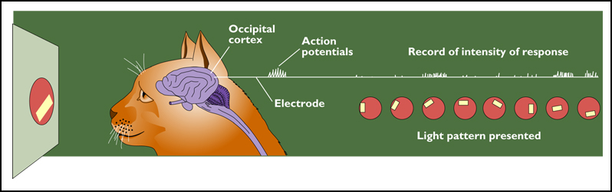
Fig. 4.44: Hubel and Wiesel (1981)—obtained important evidence for existence of feature detectors—won the Nobel Prize
Feature detectors have been discovered for: 1) orientation and 2) motion
Experiment; Hubel and Wiesel implanted electrodes to record the activity of neurons in the occipital cortex of a cat. Then they compared the responses evoked by various patterns of light and darkness on the retina.
In most cases a neuron responded vigorously when a portion of the retina saw a bar of light oriented at a particular angle. When the angle of the bar changed, that cell became silent but another cell responded.
Different cells fired for response to movement in particular directions: eg. vertical, horizontal bars of light
.
Notes:
Figure 4.44
Important evidence for the existence of feature detectors comes from the Nobel Prize winning research of Hubel and Wiesel (1981).
They inserted thin electrodes into cells of the visual cortex in monkeys and cats and recorded activity of those cells when different light patterns were shown to the animals.
The researchers were able to identify cells that fired only in the presence of vertical bars of light, and others that only fired for horizontal bars.
In later experiments, they found cells that only fired in response to movement in particular directions.

Slide 63
The waterfall illusion experienced by humans is evidence that humans do indeed have feature detectors.
In this illusion, a person first stares at a waterfall for one minute or more.
If the person then looks at cliffs immediately after staring at the waterfall, the cliffs will appear to “flow upward”.
This suggests that the cells that detect downward motion have become fatigued from the act of staring at the waterfall.
Another motion aftereffect

Slide 64
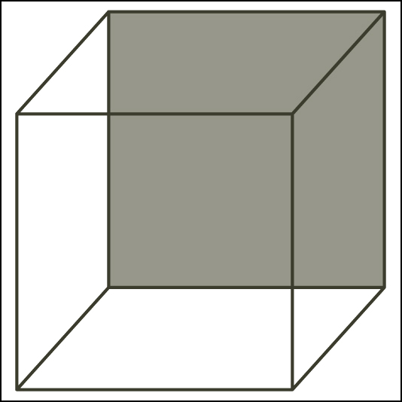
Imposing meaning
Fig. 4.23: Necker cube
Notes:
Figure 4.23
The Necker cube. The tinted surface can become either the front or the back of the cube.
Do feature detectors explain perception?
Scientists believe that feature detectors are just a first step in a series of complex processes that create perception.
Simple visual illusions such as the Necker cube suggest that we must also actively impose meaning on images that we see.
There is a branch of psychology that specializes in explaining how humans arrive at the integrated whole images and make meaningful interpretations of the visual world.

Slide 65
Gestalt psychology focuses on the human ability to perceive overall patterns.
The word Gestalt has no true English equivalent, but is close to synonymous with “pattern” or “configuration.”
According to Gestalt psychologists, visual perception is an active creation, not merely the adding up of lines and movement.

Slide 66
Perceptual grouping
Figure-Ground Organization: Inborn part of a stimulus stands out as a figure (object) against a less prominent background (ground)
Reversible Figure: When figure and ground that can be reversed

Slide 67
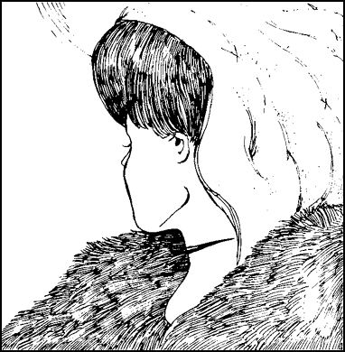
Figure vs ground ?
Order on an array vs addition of small features
Notes:
Principles of Gestalt Psychology
When looking at an image, we make a distinction between figure and ground.
This is a picture of a reversible figure – a stimulus that can be perceived in more than one way. When we decide which side is the front of the object, then we will see it as a stable image. We are imposing order on an array, not just adding up small features.

Slide 68
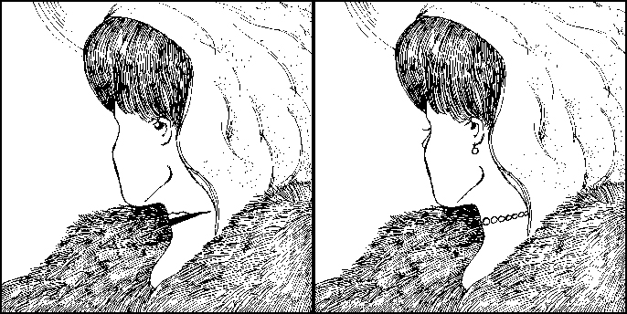
Figure 4.22
Unambiguous drawings of the young and old woman. These versions of the reversible figure in Figure 4.21 have been redrawn slightly to make the young woman more apparent on the right and the old woman more apparent on the left.

Slide 69

FIGURE 4.29 A reversible figure-ground design. Do you see two faces in profile or a wineglass?

Slide 70



Slide 71
Gestalt Principles of Organization
Proximity (or Nearness): Stimuli that are near each other tend to be grouped together
Similarity: Stimuli that are similar in size, shape, color, or form tend to be grouped together
Closure: Tendency to complete a figure so that it has a consistent overall form
Connectedness/Common Region: Stimuli that are found within a common area tend to be seen as a group

Slide 72
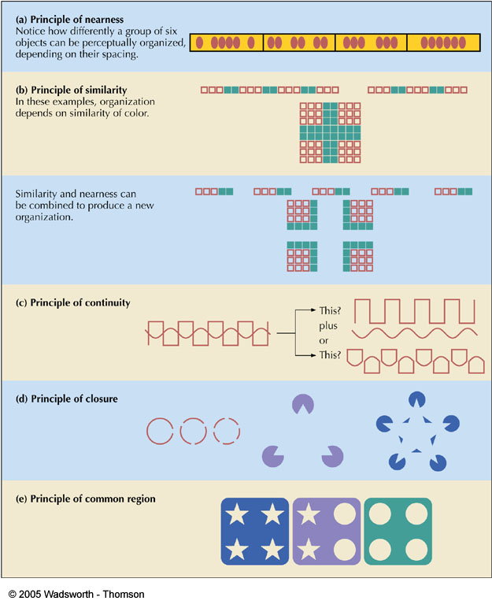
FIGURE 4.30 How we organize perceptions.

Slide 73
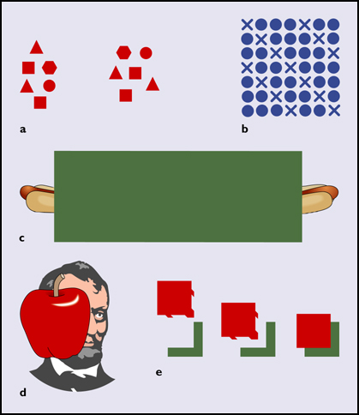
Figure 4.51
Gestalt principles of (a) proximity, (b) similarity, (c) continuation, (d) closure, and (e) good figure.
Notes:
Figure 4.51
Gestalt principles of (a) proximity, (b) similarity, (c) continuation, (d) closure, and (e) good figure.
The principle of proximity states that humans tend to perceive objects close together as belonging to a group.
The principle of similarity states that we perceive objects that resemble each other as forming a group.
We may perceive continuation, and fill in gaps in lines, or closure of familiar figures.
We tend to perceive a good figure, one that is simple and symmetrical.
Gestalt visual principles have analogs in the perception of sound

Slide 74
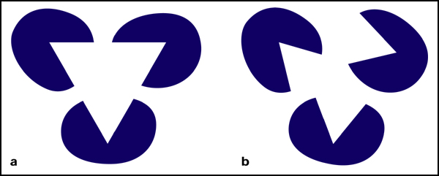
Figure 4.52
In (a) we see a triangle overlapping three irregular ovals. We see it because triangles are “good figures” and symmetrical. If we tilt the ovals, as in (b), they appear as irregular objects, not as objects with something on top of them. (From Singh, Hoffman, & Albert, 1999)

Slide 75
Perceptual expectancies (set)
Bottom-Up Processing: Analyzing information starting at the bottom (small units) and going upward to form a complete perception
Top-Down Processing: Preexisting knowledge that is used to rapidly organize features into a meaningful whole
Perceptual Set: Readiness to perceive in a particular manner, induced by small expectations

Slide 76
Perception of movement and depth
Visual constancy
Visual constancy is our tendency to perceive objects as keeping their size, shape and color even though the image that strikes our retina changes from moment to moment.
So an automobile that is driving away looks like it is moving away, not merely shrinking, even though the image on our two retinas is growing smaller.

Slide 77
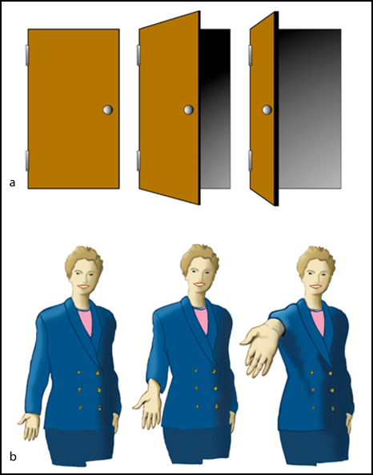
Figure 4.53
(a) Shape constancy: We perceive all three doors as rectangles. (b) Size constancy: We perceive all three hands as equal in size.

Slide 78
Depth perception
Our retinas are two-dimensional surfaces, but they give us very good depth perception – our ability to perceive distance.
There are several factors involved in creating our depth perception.
Some are binocular cues (depending on both eyes) and others are monocular (needing only one eye.)

Slide 79
Binocular cues
One important contributor is retinal disparity, which is the difference in apparent position of an object seen by each retina.
This discrepancy allows us to gauge distance.
Convergence is the degree to which our eyes must turn in to allow us to focus on a very close object.

Slide 80
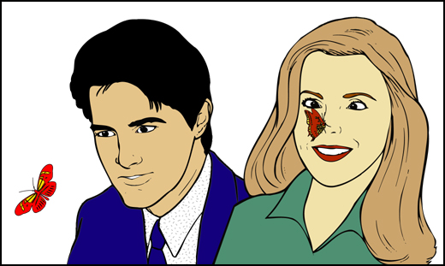
Figure 4.56
Convergence of the eyes as a cue to distance. The more this viewer must converge her eyes toward each other in order to focus on an object, the closer the object must be.

Slide 81
Depth perception
Monocular cues allow a person to judge depth and distance accurately using only one eye.
Object size can be used if we already have an idea of the approximate size of the objects.
Linear perspective, as in the case of parallel lines that converge as they approach the horizon.
Detail – generally objects that are closer can be seen in greater detail than those that are farther away.

Slide 82
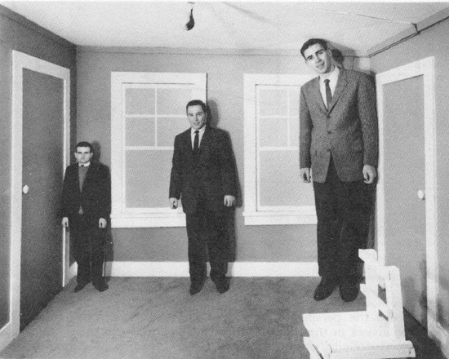
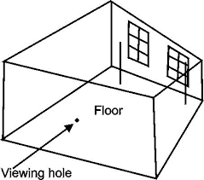
Optical illusions
When we misjudge distance, we misjudge size as well.
For example, the Ames room illusion causes us to misjudge the heights of people standing in it using a powerfully misleading set of background cues.
Notes:
An optical illusion is a misinterpretation of a visual stimulus.
Psychologists are attempting to find a parsimonious explanation for these misinterpretations.
Many can be explained by considering the relationship between size perception and depth perception.

Slide 83
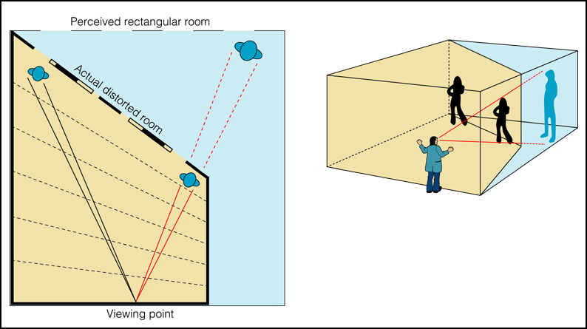
FIGURE 4.62b
The Ames room is a study in deceptive perception, designed to be viewed through a peephole with one eye. (b) This diagram shows the positions of the people in the Ames room and demonstrates how the illusion of distance is created. (Wilson et al., 1964)
Notes:
We see an immensely tall and a very short person, but once we remove all the misleading cues, we realize that they are people of similar height standing at different distances in relation to us.

Slide 84
Depth perception
Definition: Ability to see three-dimensional space and to accurately judge distances
Visual Cliff: Apparatus that looks like the edge of an elevated platform or cliff
Depth Cues: Features of environment, and messages, that supply information about distance and space
Monocular Depth Cue: Depth cue that can be sensed with one eye
Binocular Depth Cue: Depth cue that can be sensed with two eyes

Slide 85
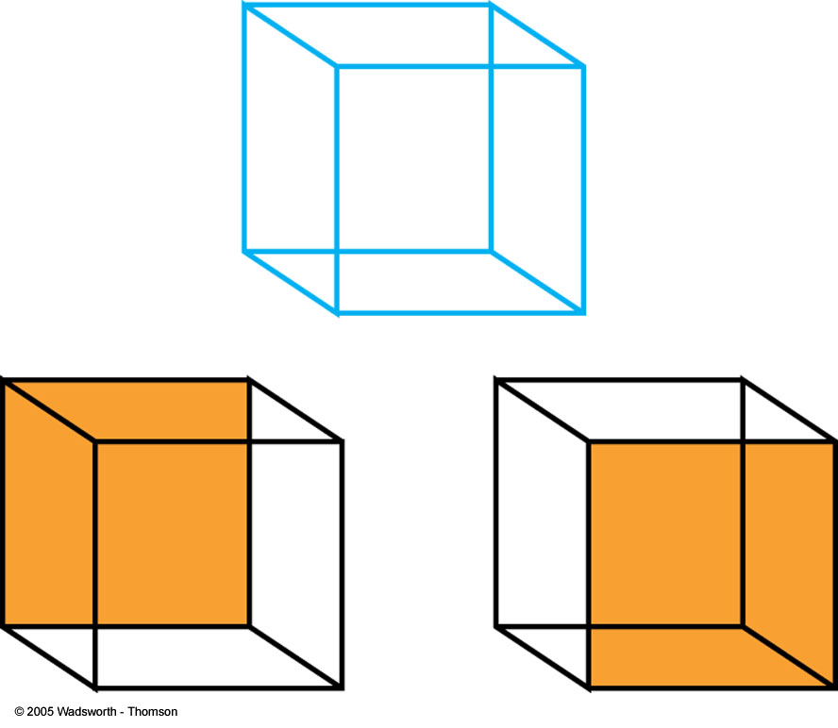
FIGURE 4.32 Necker’s cube.

Slide 86
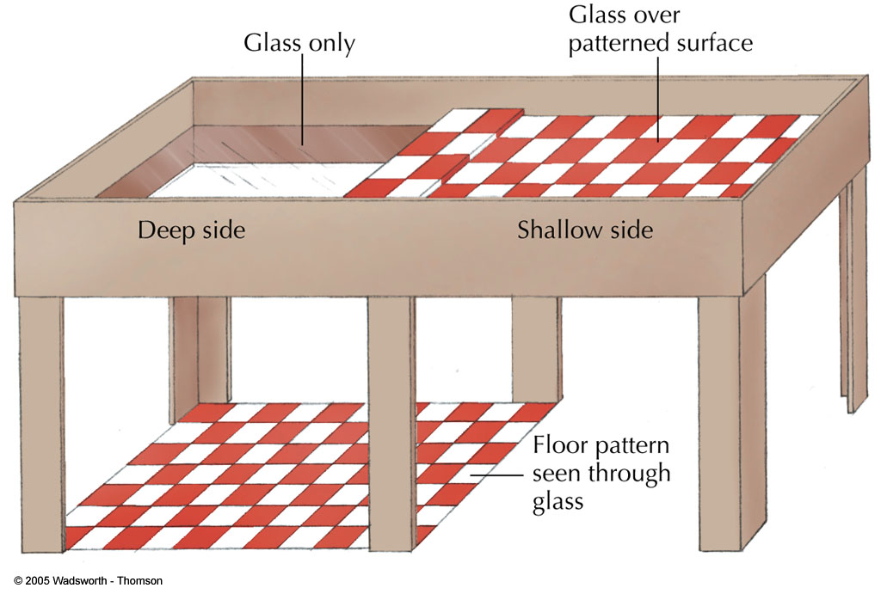
FIGURE4.34 Human infants and newborn animals refuse to go over the edge of the visual cliff.

Slide 87
Macular cues for depth perception
Accommodation: Bending of the lens of the eye to focus on nearby objects
Convergence: Binocular cue; when you look at something 50 feet or closer, your eyes must turn in (converge) to focus the object
Retinal Disparity: Discrepancy in the images that reach the right and left eyes
Stereotopic Vision: Three-dimensional sight

Slide 88
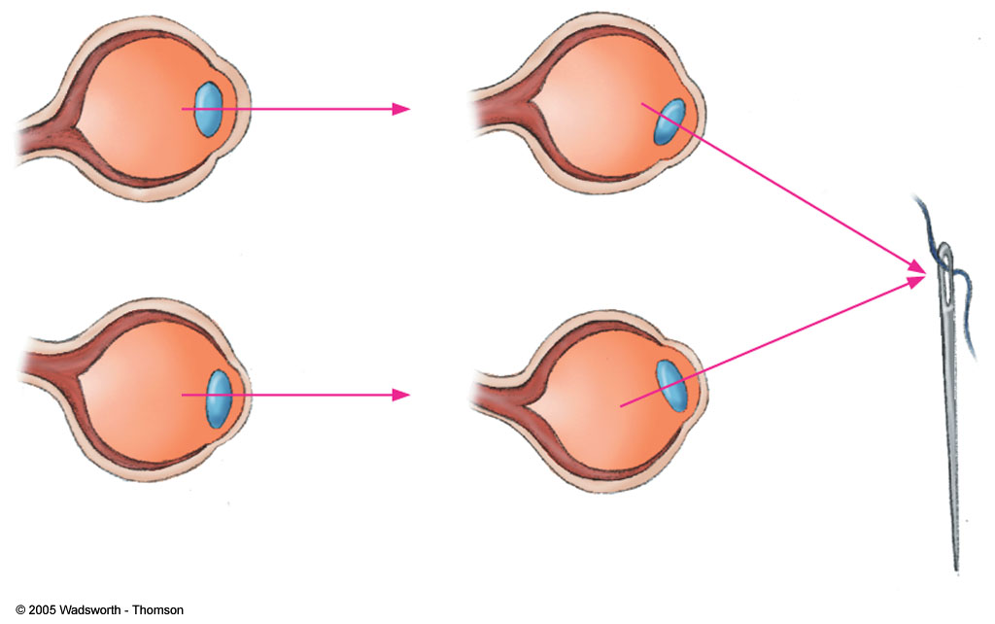
FIGURE 4.35 The eyes must converge, or turn in toward the nose, to focus on close objects.

Slide 89
Pictorial depth cues
Features found in paintings, drawings and photographs that supply information about space, depth, and distance
Linear Perspective: Based on apparent convergence of parallel lines in environment
Overlap (Interposition): When one object partially blocks another
Texture Gradients: Texture changes can contribute to depth perception; coarse texture implies closeness, fine texture implies distance
Relative Motion (Motion Parallax): Nearby objects move a lot as your head moves; distant objects move slightly

Slide 90
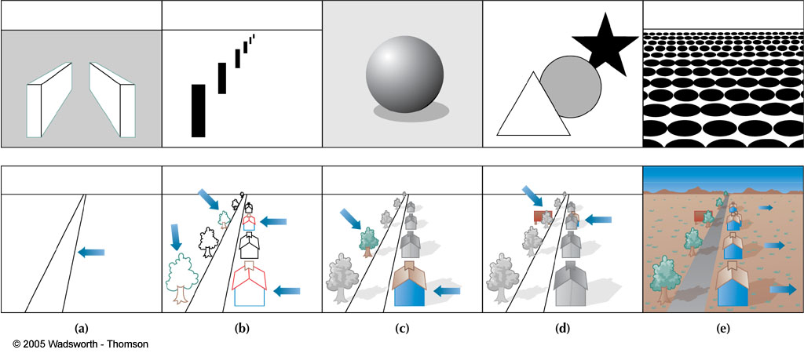
FIGURE4.38 (a) Linear perspective. (b) Relative size. (c) Light and shadow. (d) Overlap. (e) Texture gradients. Drawings in the top row show fairly “pure” examples of each of the pictorial depth cues. In the bottom row, the pictorial depth cues are used to assemble a more realistic scene.

Slide 91
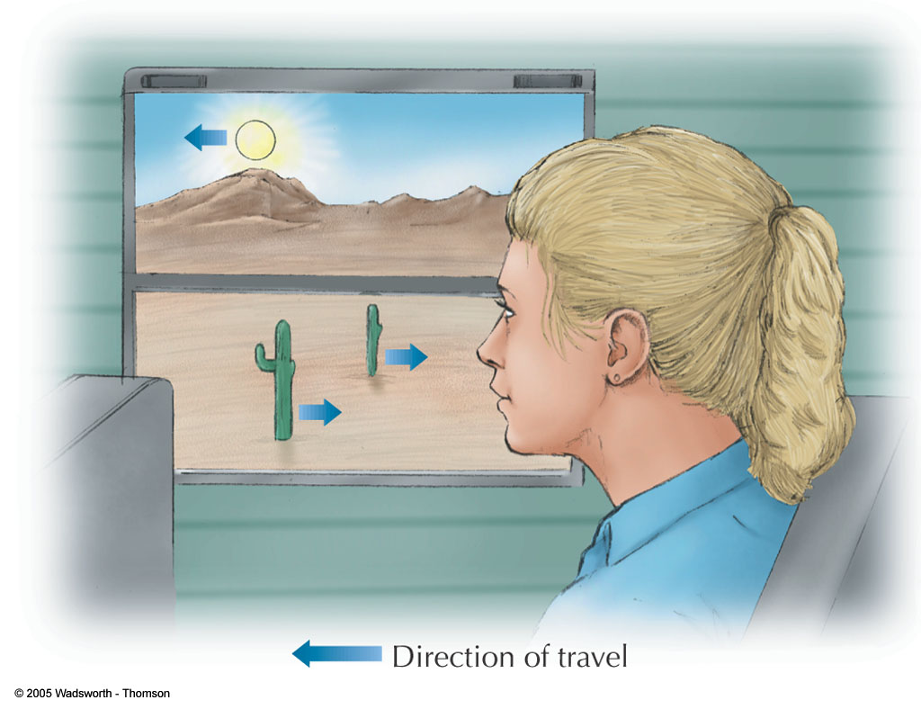
FIGURE 4.41 The apparent motion of objects viewed during travel depends on their distance from the observer. Apparent motion can also be influenced by an observer’s point of fixation. At middle distances, objects closer than the point of fixation appear to move backward; those beyond the point of fixation appear to move forward. Objects at great distances, such as the sun or moon, always appear to move forward.

Slide 92
Moon Illusion: Apparent change in size that occurs as the moon moves from the horizon (large moon) to overhead (small moon)
Apparent-Distance Hypothesis: Horizon seems more distant than the night sky

Slide 93
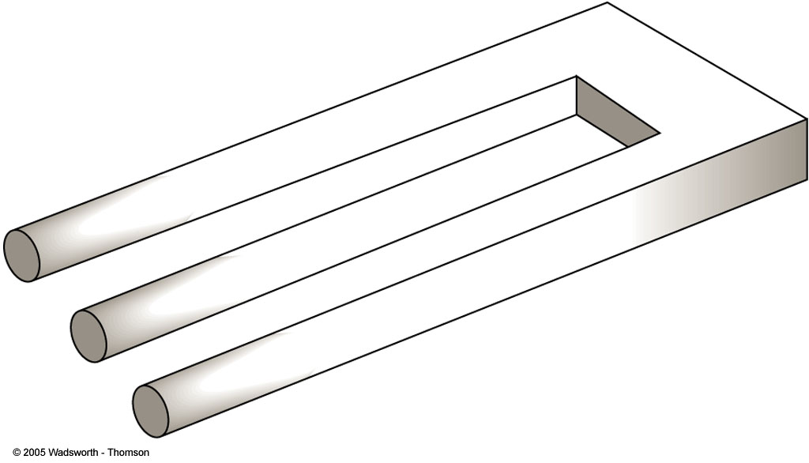
FIGURE 4.33 (Left) An impossible figure—the “three-pronged widget.” (Right) It might seem that including more information in a drawing would make perceptual conflicts impossible. However, Japanese artist Shigeo Fukuda has shown otherwise. (Disappearing Column, © Shigeo Fukuda, 1985.)

Slide 94
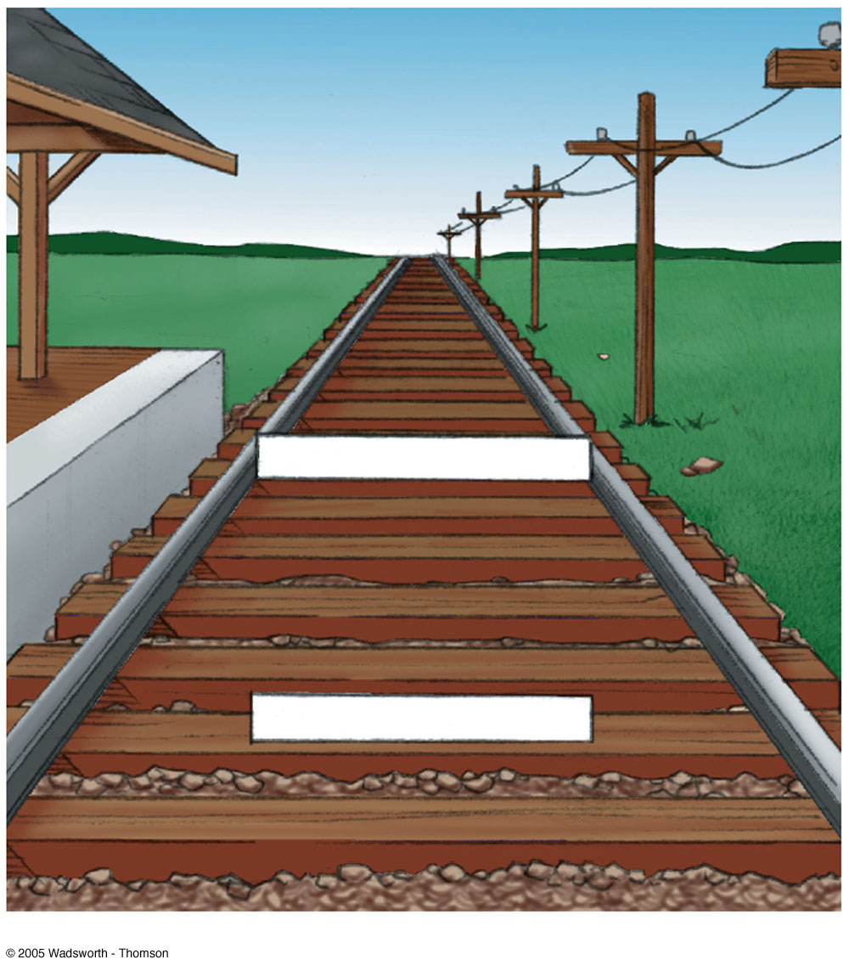
FIGURE 4.42 The Ponzo illusion may help you understand the moon illusion. Picture the two white bars as resting on the railroad tracks. In the drawing, the upper bar is the same length as the lower bar. However, because the upper bar appears to be farther away than the lower bar, we perceive it as longer. The same logic applies to the moon illusion.

Slide 95
Perceptual learning
Change in the brain that alters how we process sensory information
Perceptual Reconstructions: Mental models of external events
Perceptual Habits: Ingrained patterns of organization and attention

Slide 96
Illusion
Illusion: Misleading or distorted perceptions of stimuli that actually exist in the external world
Hallucination: When people perceive objects or events that have no external basis in reality
Muller-Lyer Illusion: Two equal-length lines topped with inward or outward pointing V’s appear to be of different length; based on experience with edges and corners

Slide 97

FIGURE 4.44 It is difficult to look at this simple drawing without perceiving depth. Yet, the drawing is nothing more than a collection of flat shapes. Turn this page counterclockwise 90 degrees, and you will see three C’s, one within another. When the drawing is turned sideways, it seems nearly flat. However, if you turn the page upright again, a sense of depth will reappear. Clearly, you have used your knowledge and expectations to construct an illusion of depth. The drawing itself would only be a flat design if you didn’t invest it with meaning.

Slide 98

FIGURE 4.47 Some interesting perceptual illusions. Such illusions are a normal part of visual perception.

Slide 99

FIGURE 4.48 Why does line (b) in the Müller-Lyer illusion look longer than line (a)? Probably because it looks more like a distant corner than a nearer one. Because the vertical lines form images of the same length, the more “distant” line must be perceived as larger. As you can see in the drawing on the right, additional depth cues accentuate the Müller-Lyer illusion.

Slide 100
?Extrasensory perception
Parapsychology: Study of ESP and other psi phenomena (events that seem to defy accepted scientific laws)
Clairvoyance: Purported ability to perceive events unaffected by distance or normal physical barriers
Telepathy: Purported ability to read someone else’s mind
Precognition: Purported ability to accurately predict the future
Psychokinesis (Mind Over Matter): Purported ability to influence inanimate objects by willpower

Slide 101
Zener Cards: Deck of 25 cards, each having one of five symbols
Run of Luck: Statistically unusual outcome that could occur by chance alone (e.g., getting five heads in a row, two jackpots within six pulls of a slot machine)
Stage ESP: Simulation of ESP for entertainment purposes
Conclusion: Existence of ESP has NOT been scientifically demonstrated; positive results are usually inconclusive and easily criticized
In sum: Be skeptical! If it seems too good to be true, it probably is!

Slide 102

FIGURE 4.52 ESP cards used by J. B. Rhine, an early experimenter in parapsychology.

Slide 103
Factors Affecting the Accuracy of Eyewitness Perceptions
Post-Event Information: Testimony reflects not only what was actually seen but also information obtained later on
Attitudes and Expectations: May affect eyewitness’s perception of events
Cross-Racial Perceptions: Eyewitnesses are better at identifying members of their own race than of other races
Weapon Focus: Presence of a weapon impairs eyewitness’s accuracy
Accuracy-Confidence: Confidence is not a good predictor of his/her accuracy

Slide 104

FIGURE 4.49 Emotionally significant stimuli influence attention.

Slide 105
Exposure Time: Less time an eyewitness has to observe an event, the less s/he will perceive and remember it
Unconscious Transference: A culprit who is identified may have been seen in another situation or context
Color Perception: Judgments of color made under monochromatic light are very unreliable
Stress: High levels impair accuracy

Slide 106
Perceptual awareness
Reality Testing: Obtaining additional information to check on accuracy of perceptions
Habituation: Decrease in perceptual response to a given stimulus
Dishabituation: A reversal of habituation

Slide 107

FIGURE 4.54 The limits of pure perception. Even simple designs are easily misperceived. Fraser’s spiral is actually a series of concentric circles. The illusion is so powerful that people who try to trace one of the circles sometimes follow the illusory spiral and jump from one circle to the next.

